Slide 1
Cloud Computing
Lab1
Phoebe Wu

Slide 2
Part-I: Compute Instances

Slide 3
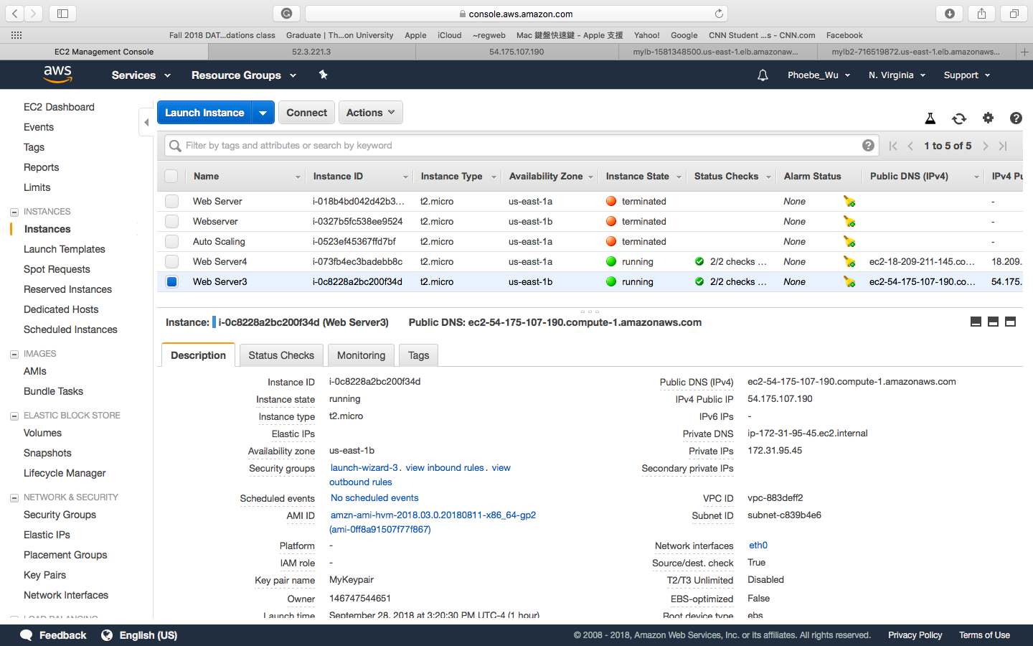
Launch EC2 instance

Slide 4
Virtualization Type of EC2
I think Amazon EC2 is a kind of Hardware virtualization.

Slide 5

Exercise-2(Setup Flask and run hello.py ):

Slide 6
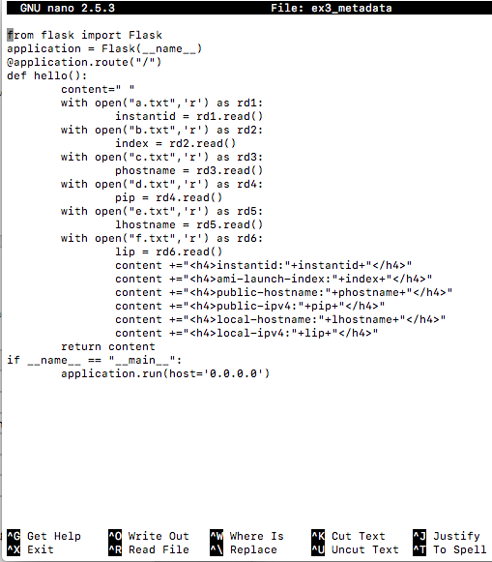
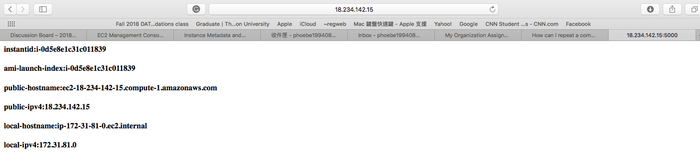
Exercise-3(Meta-data flask application ):
First, run the commands:
curl http://169.254.169.254/latest/meta-data/instance-id > a.txt
curl http://169.254.169.254/latest/meta-data/instance-id > b.txt
curl http://169.254.169.254/latest/meta-data/public-hostname > c.txt
curl http://169.254.169.254/latest/meta-data/public-ipv4 > d.txt
curl http://169.254.169.254/latest/meta-data/local-hostname > e.txt
curl http://169.254.169.254/latest/meta-data/local-ipv4 > f.txt
The output:

Slide 7
Part-II: Load Balancing

Slide 8
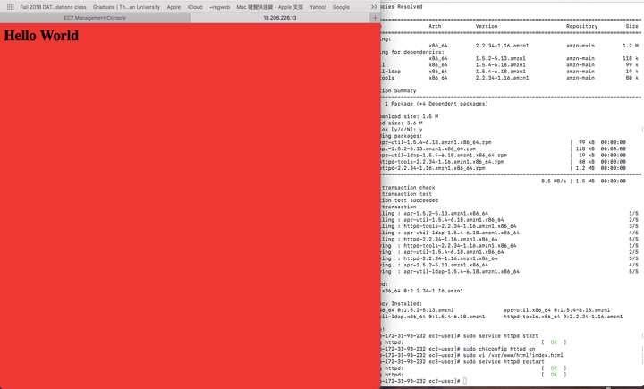
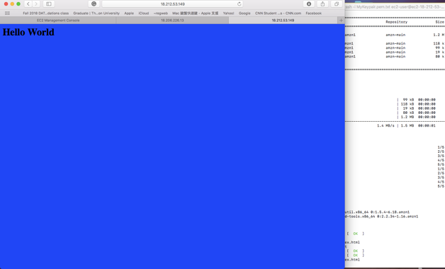
Create two instances and run the hello.py

Slide 9
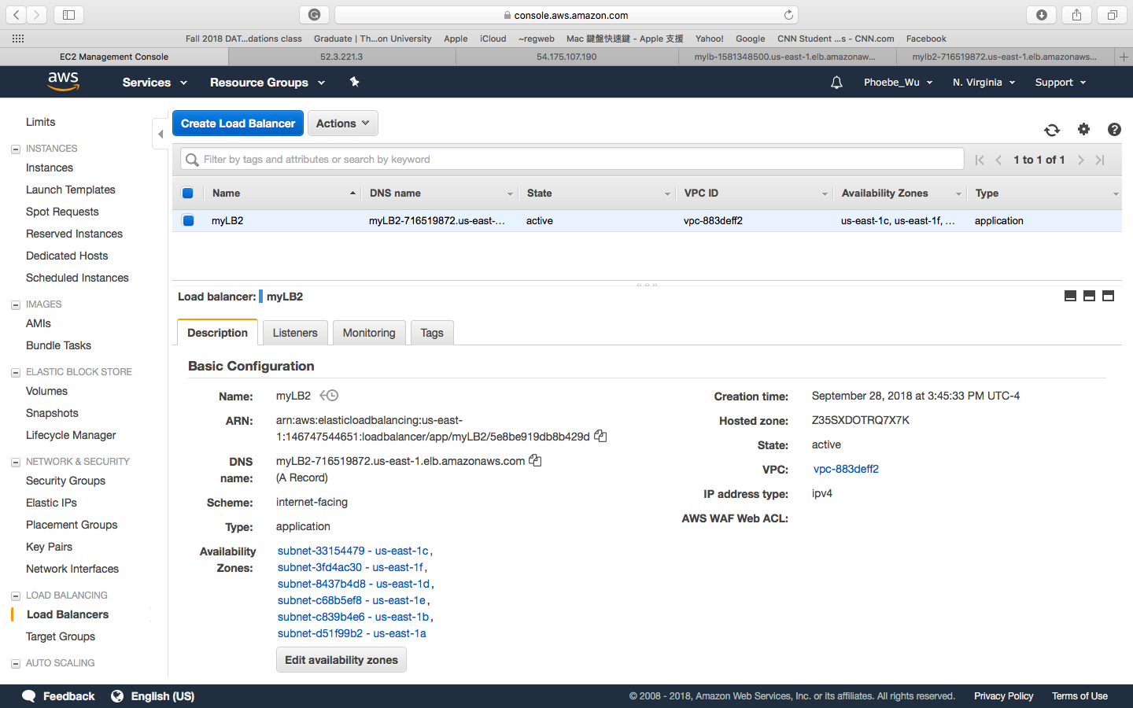
ELB details and web application

Slide 10


Exercise-1(My load balancer link):

Slide 11
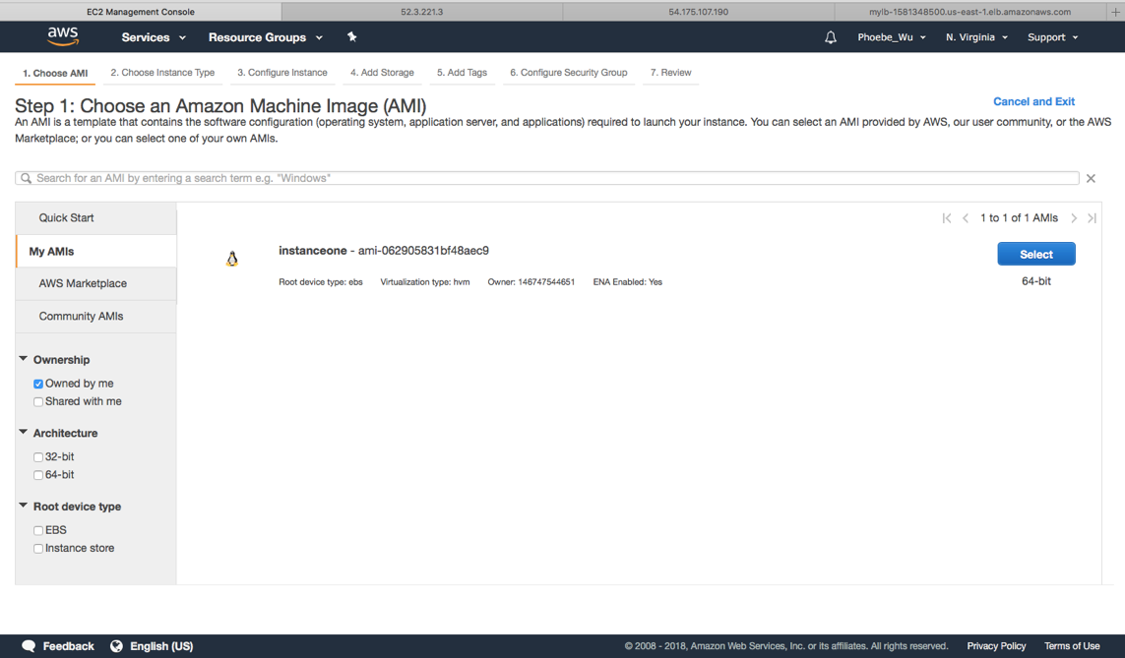
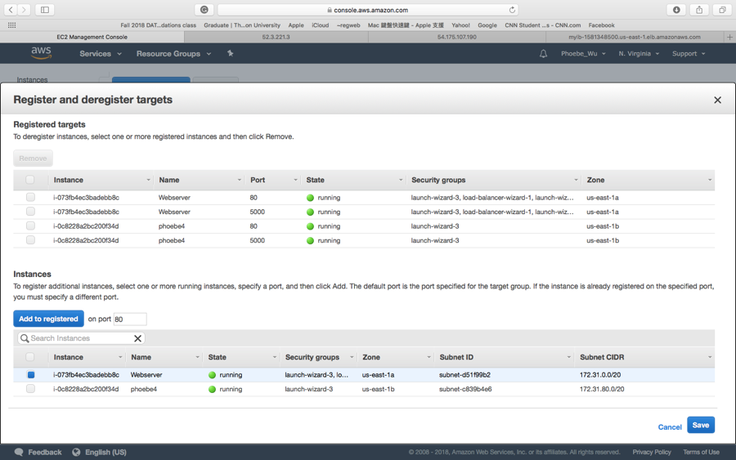
Create custom AMI

Slide 12
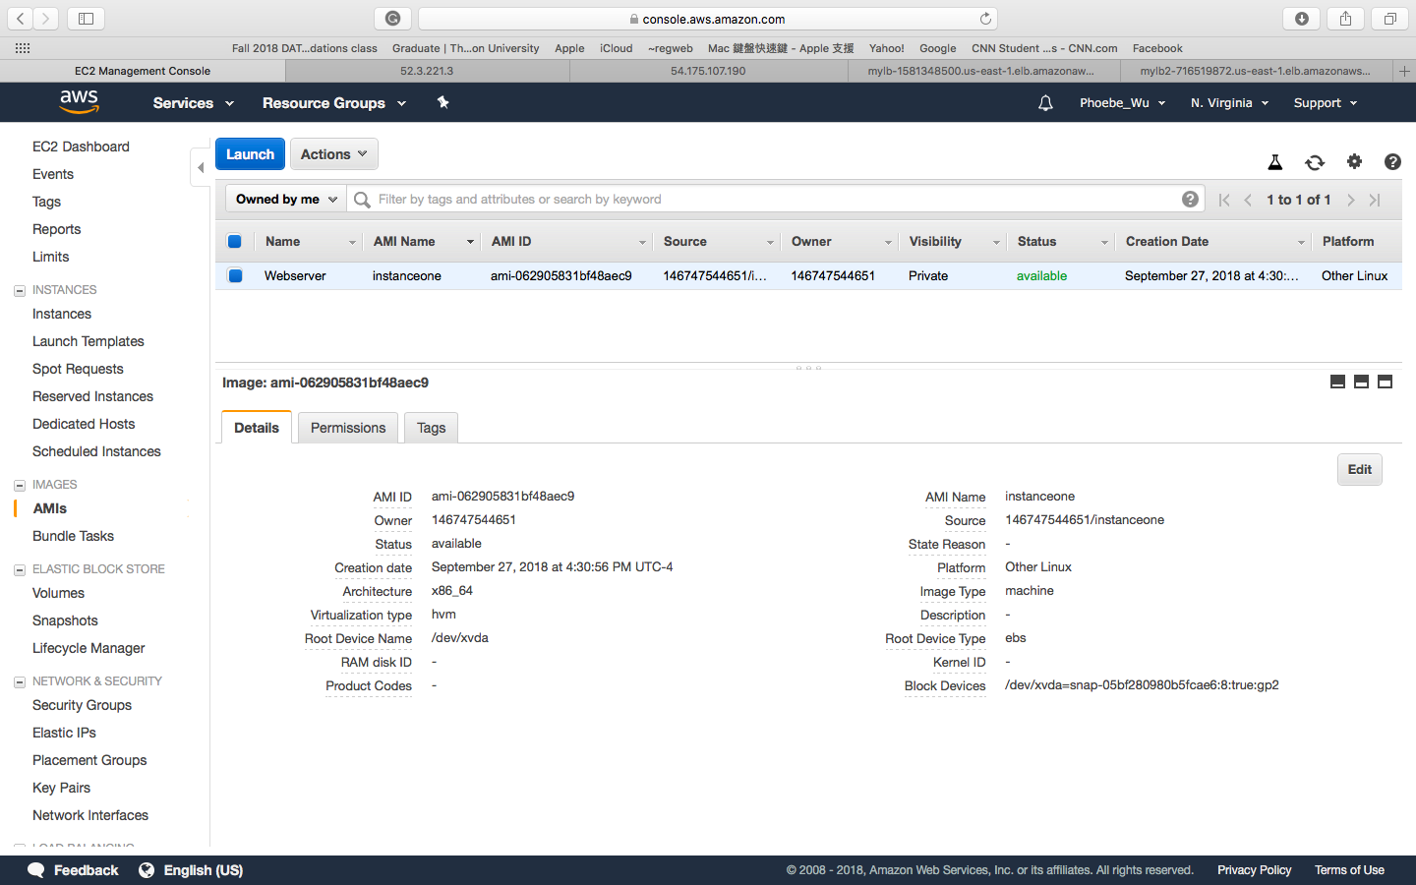
My AMI

Slide 13


New Load Balance after creating AMI

Slide 14
Part-III: Auto Scaling

Slide 15
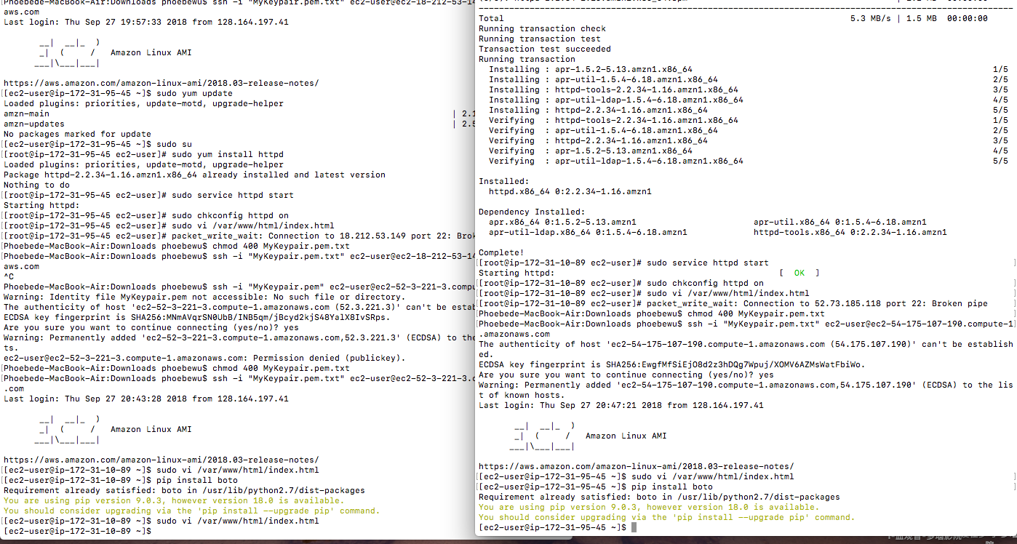
Python boto setup

Slide 16
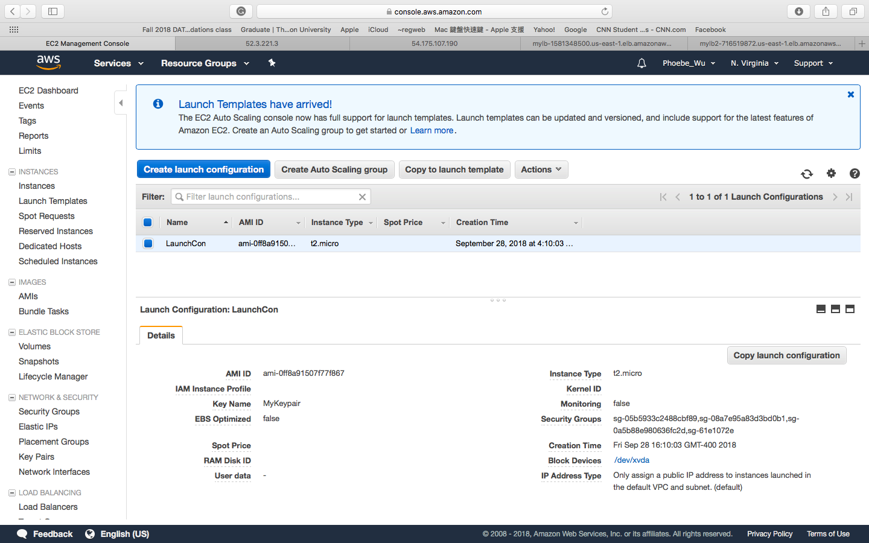
Create Launch Configuration

Slide 17
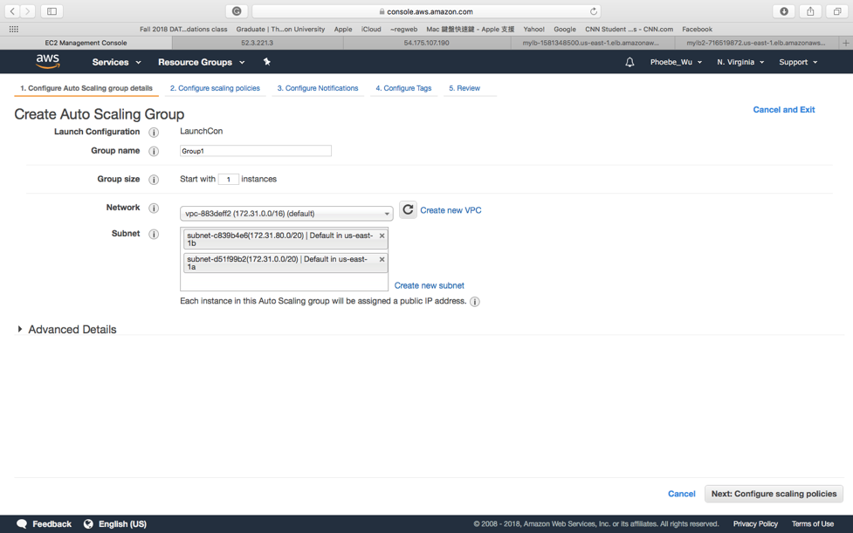
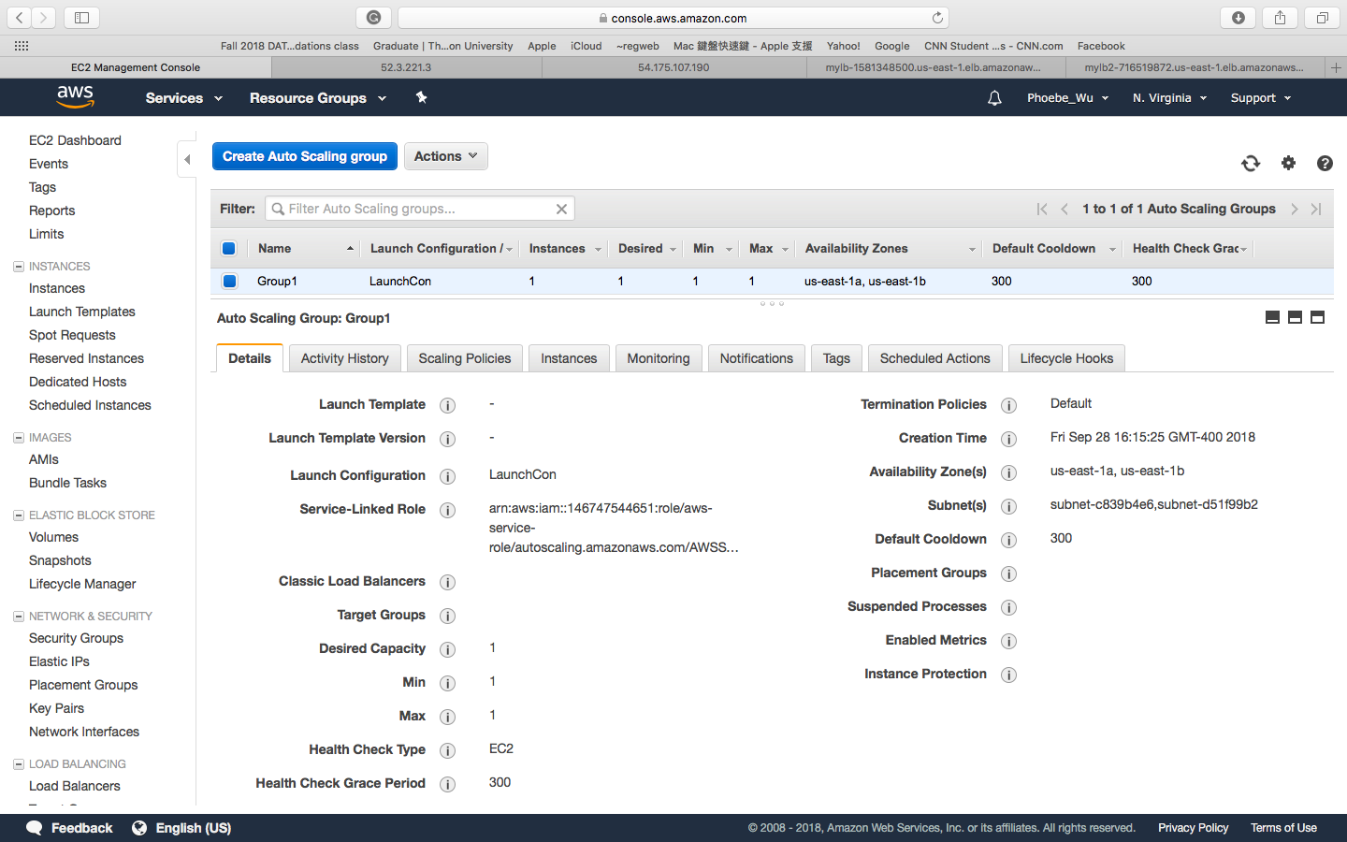
Create Auto Scaling group

Slide 18
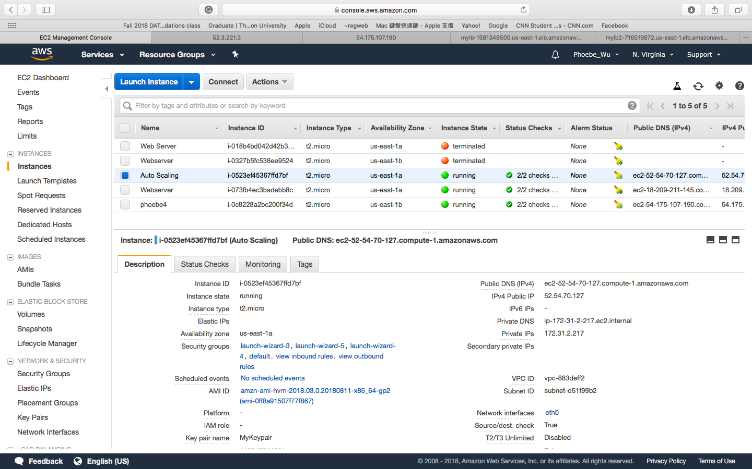
My Autoscaling Instance

Slide 19
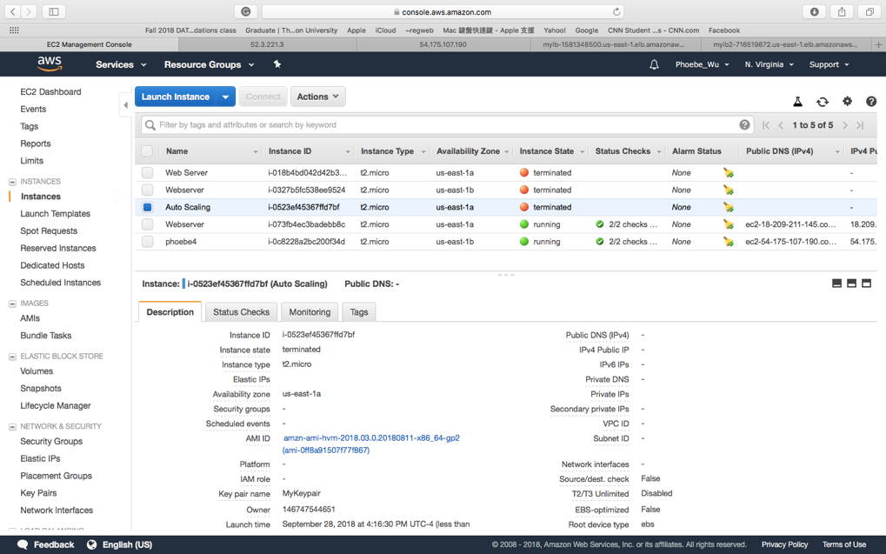
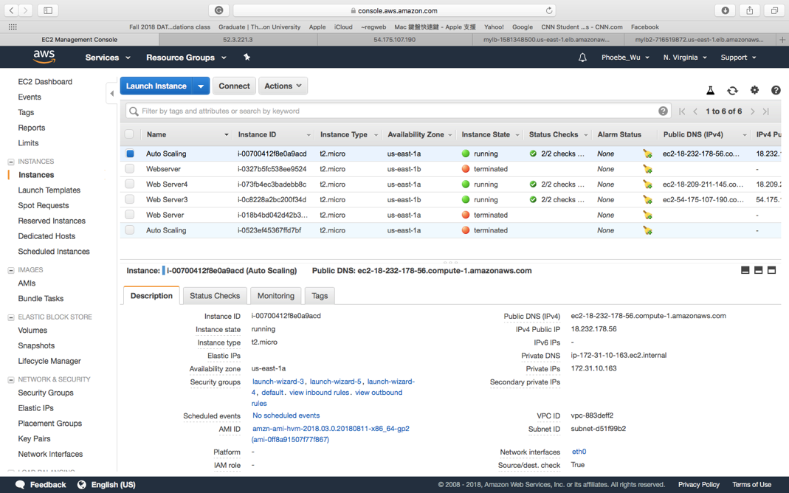
Test Auto Scaling by Terminate the Auto Scaling Instance
The Auto Scaling Instance automatically provisioned within 5 minutes.

Slide 20
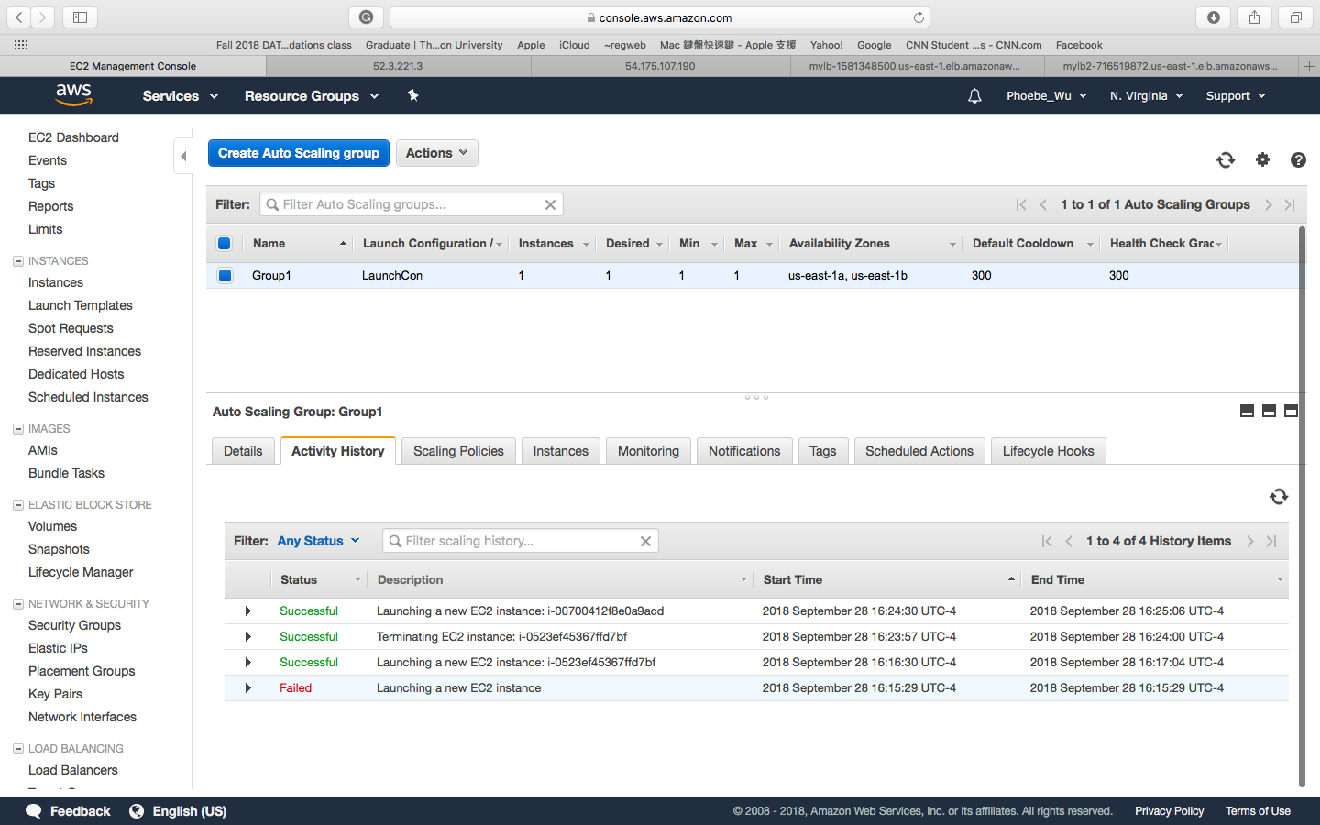
Auto Scaling Group History

